Slide 1



The Day & Night Cycle

Slide 2

What causes day and night?
As our Earth turns, the sun’s place in the sky changes throughout the day.
In turn, the sun appears to rise in the morning, move across the sky throughout the day, and then go down at night.

Slide 3

Orbit- Revolve
Orbit means something moves in a path.
One way the planets move is by orbiting the sun. This means they go around the sun.

Slide 4
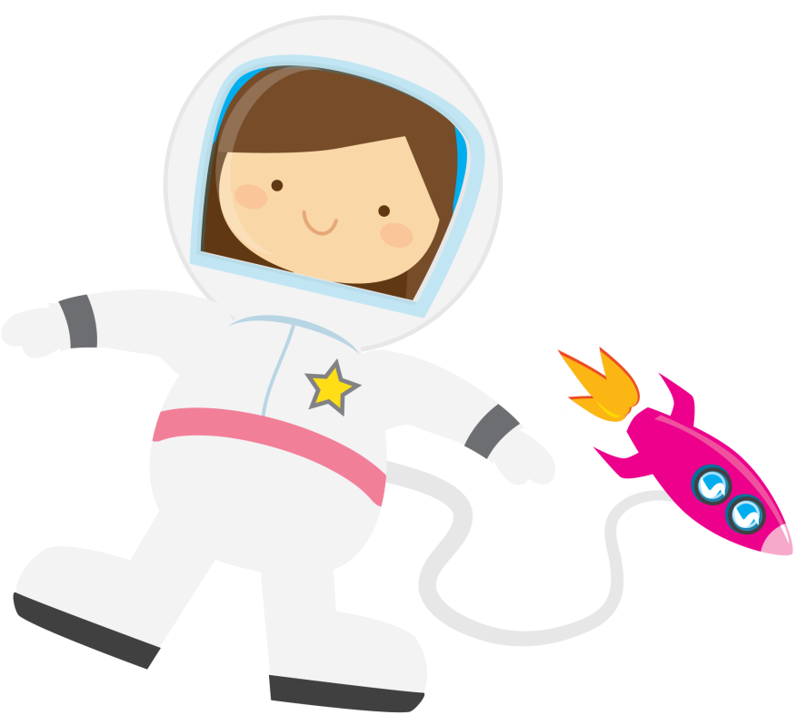
Rotate
While orbiting the sun, the planets move in another way.
They rotate which means to turn on their axis.
An axis is an imaginary line that goes through the middle of an object.
Earth’s axis goes through its North Pole and South Pole.

Slide 5
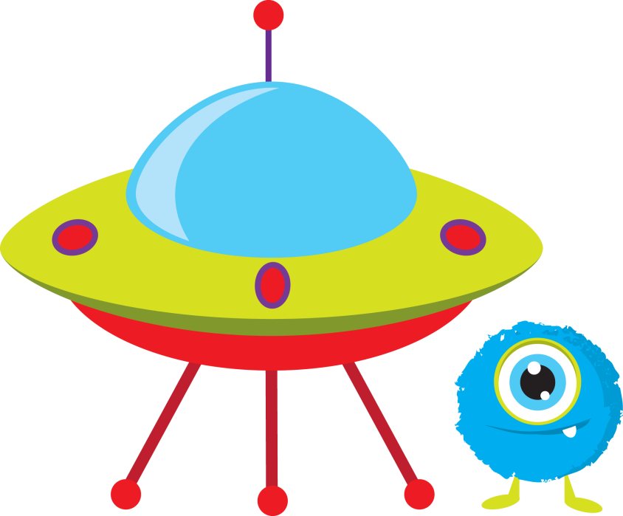
Day and Night
The sun does not move, but the earth does.
In the morning, when the sun comes up, this is when the part of Earth where you live is facing the sun.
Throughout the day, earth is still rotating. This is why the sun appears to move across the sky.
Then, as the earth continues to rotate, the part of Earth where you live turns away from the sun. This looks like the sun is going down or setting. Now, it is nighttime.

Slide 6

Sunrise and Sunset
The sun rises in the east and appears to gradually rise higher in the sky.
By noon, the sun seems to be at the highest point in the sky.
As the earth turns, the sun appears to gradually go down, and sets in the west.

Slide 7
Shadows
Early Morning | Noon | Late Afternoon
Sunlight
Sunlight
Sunlight
Shadow
Shadow
Shadow

Slide 8


Terms of Use
Thank you for downloading my Day & Night Cycle PowerPoint. I hope that you enjoy using it as a valuable resource in your classroom! Please let me know if you have any questions or concerns. My email is teachersgonewild2@gmail.com.
©Kara Lee 2013
This resource entitles you to single classroom use only. Please do not share with grade level teams or district wide or post/resell any part of this resource. If you would like to share this resource with others, please purchase multiple licenses.
I’d love to hear your feedback! www.teacherspayteachers.com/Store/Teachers-Gone-Wild

Slide 9
